Slide 1


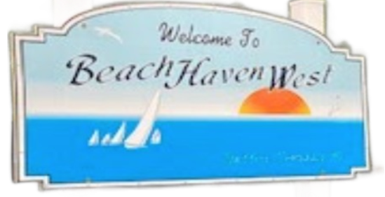
WATER QUALITY IN
BEACH HAVEN WEST, NJ
Thea Rosenzweig and Sadie Steiner
2023 Save Barnegat Bay Student Grant Program

Slide 2
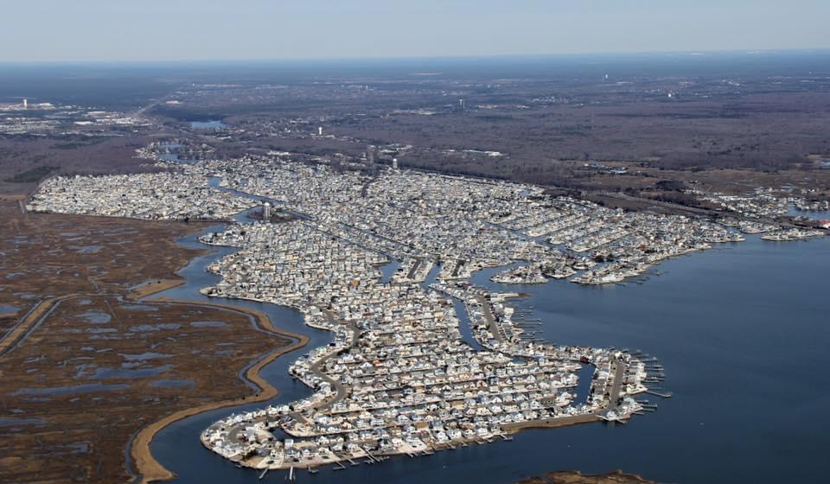
Overview
Area of Study
Beach Haven West (BHW), Stafford Township, NJ
Who is our data for?
Stafford Township
Beach Haven West Civic Association
Citizen Science

Slide 3
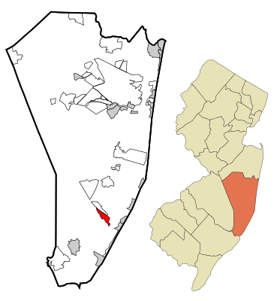
Research Questions
How does flow velocity differ at points along the Mill Creek in BHW?
  Are other water quality parameters affected?
Are harmful bacteria present
at various sites in BHW?

Slide 4
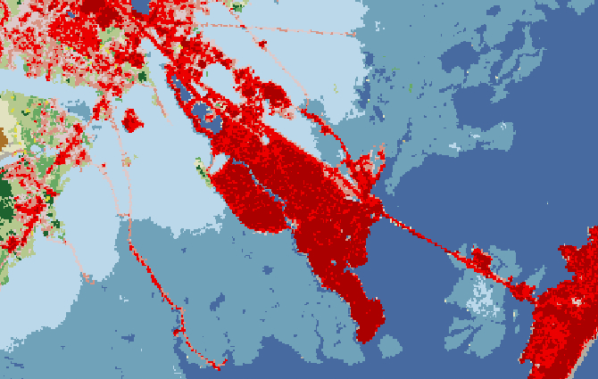
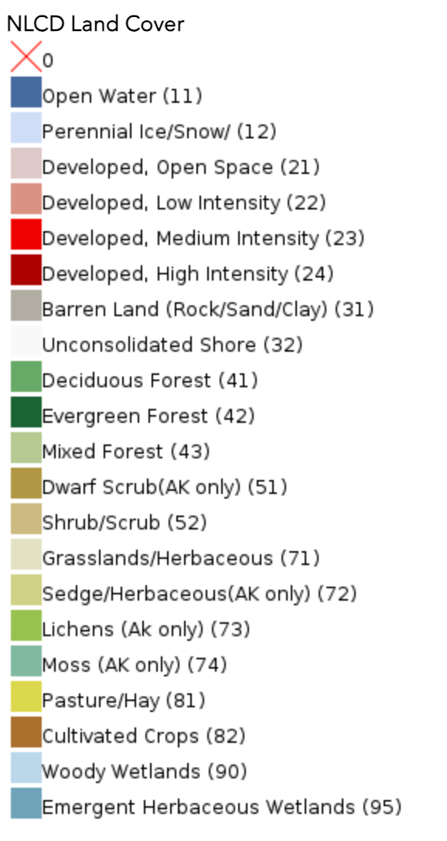
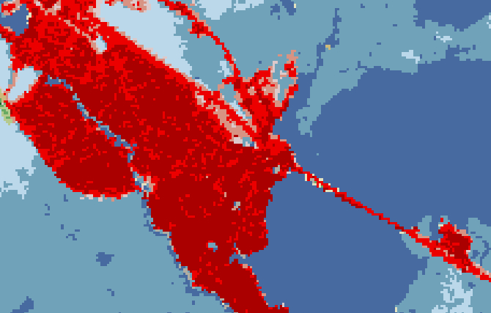
BHW Land Use

Slide 5
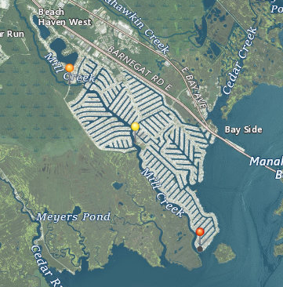
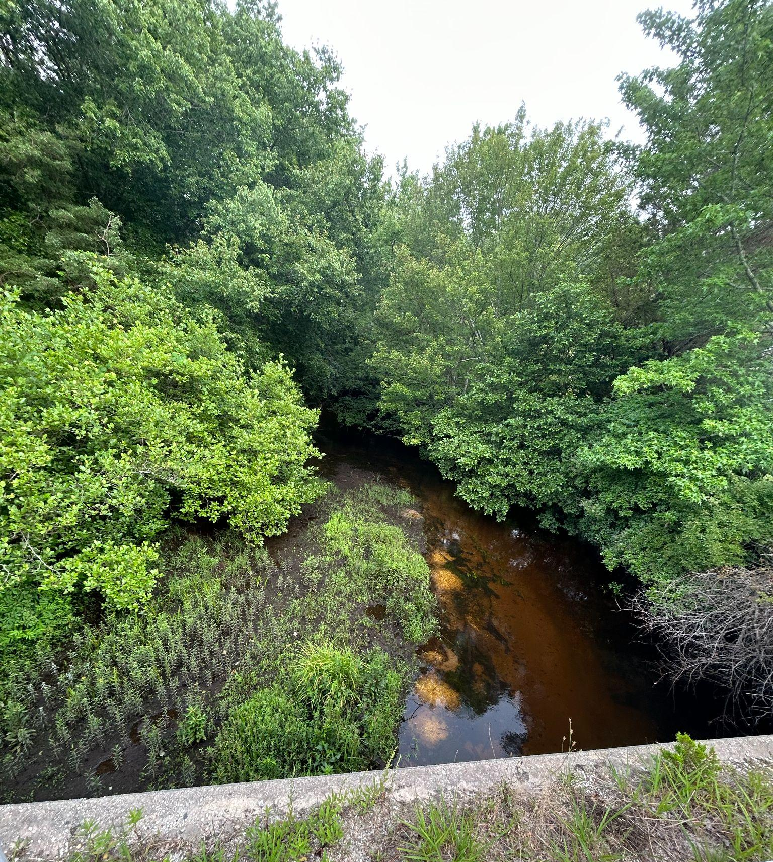
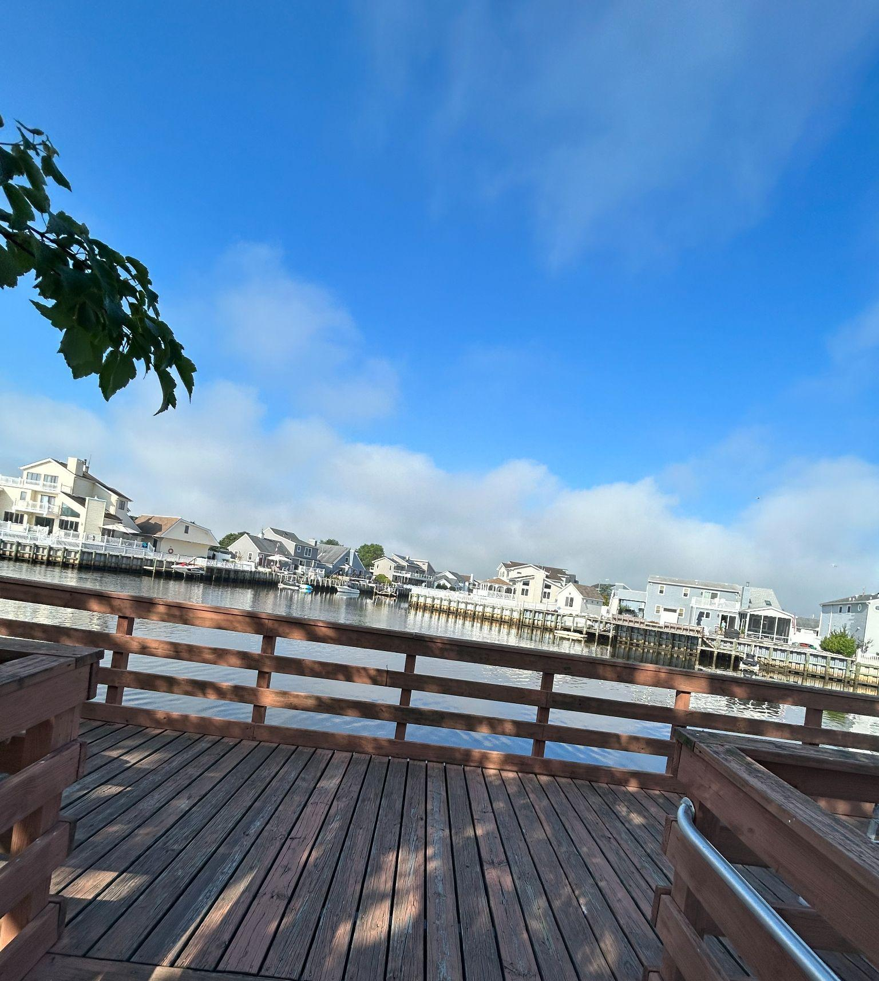
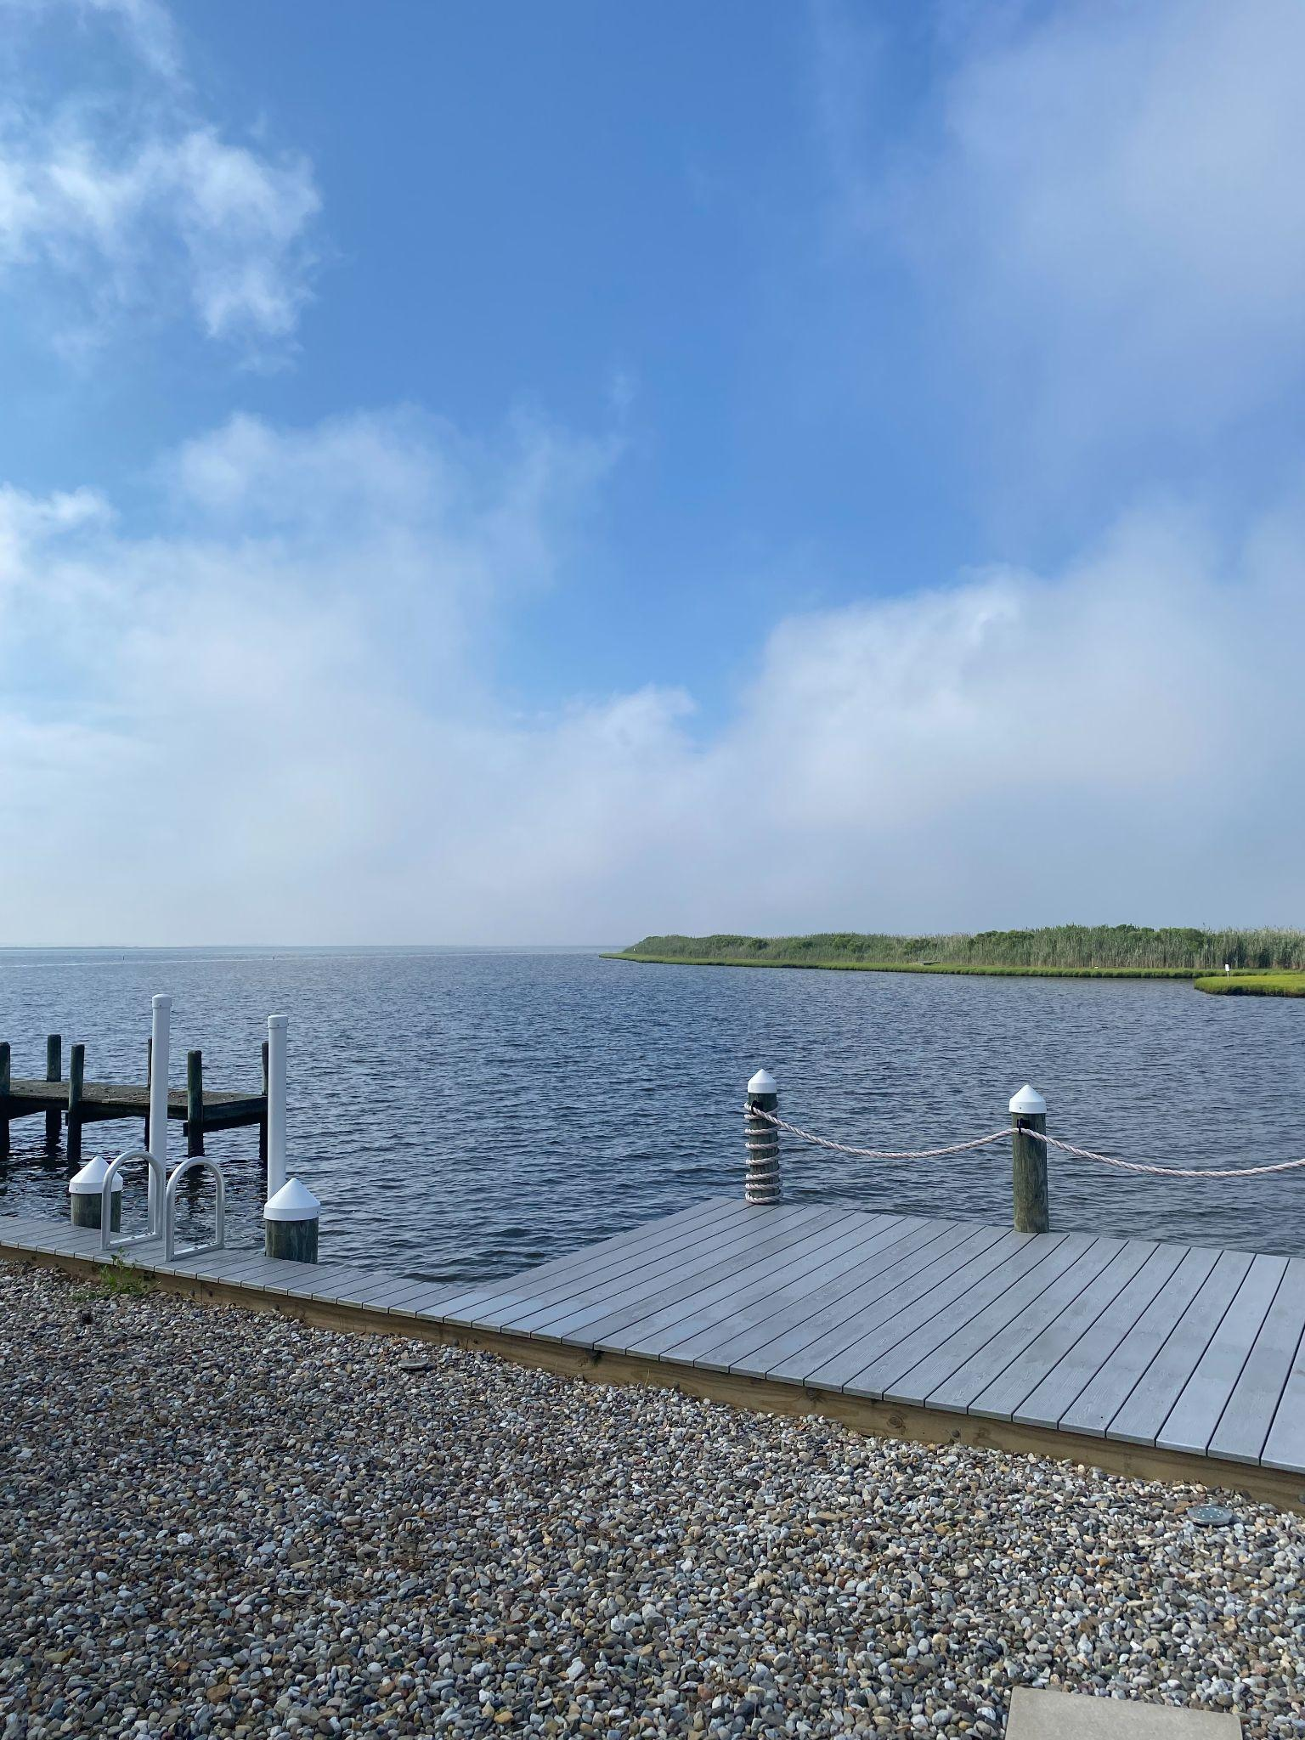



Flow Velocity Study Sites
Jennings Blvd
Mill Creek Park
1807 Mill Creek Rd

Slide 6
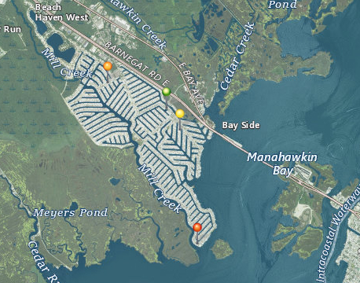
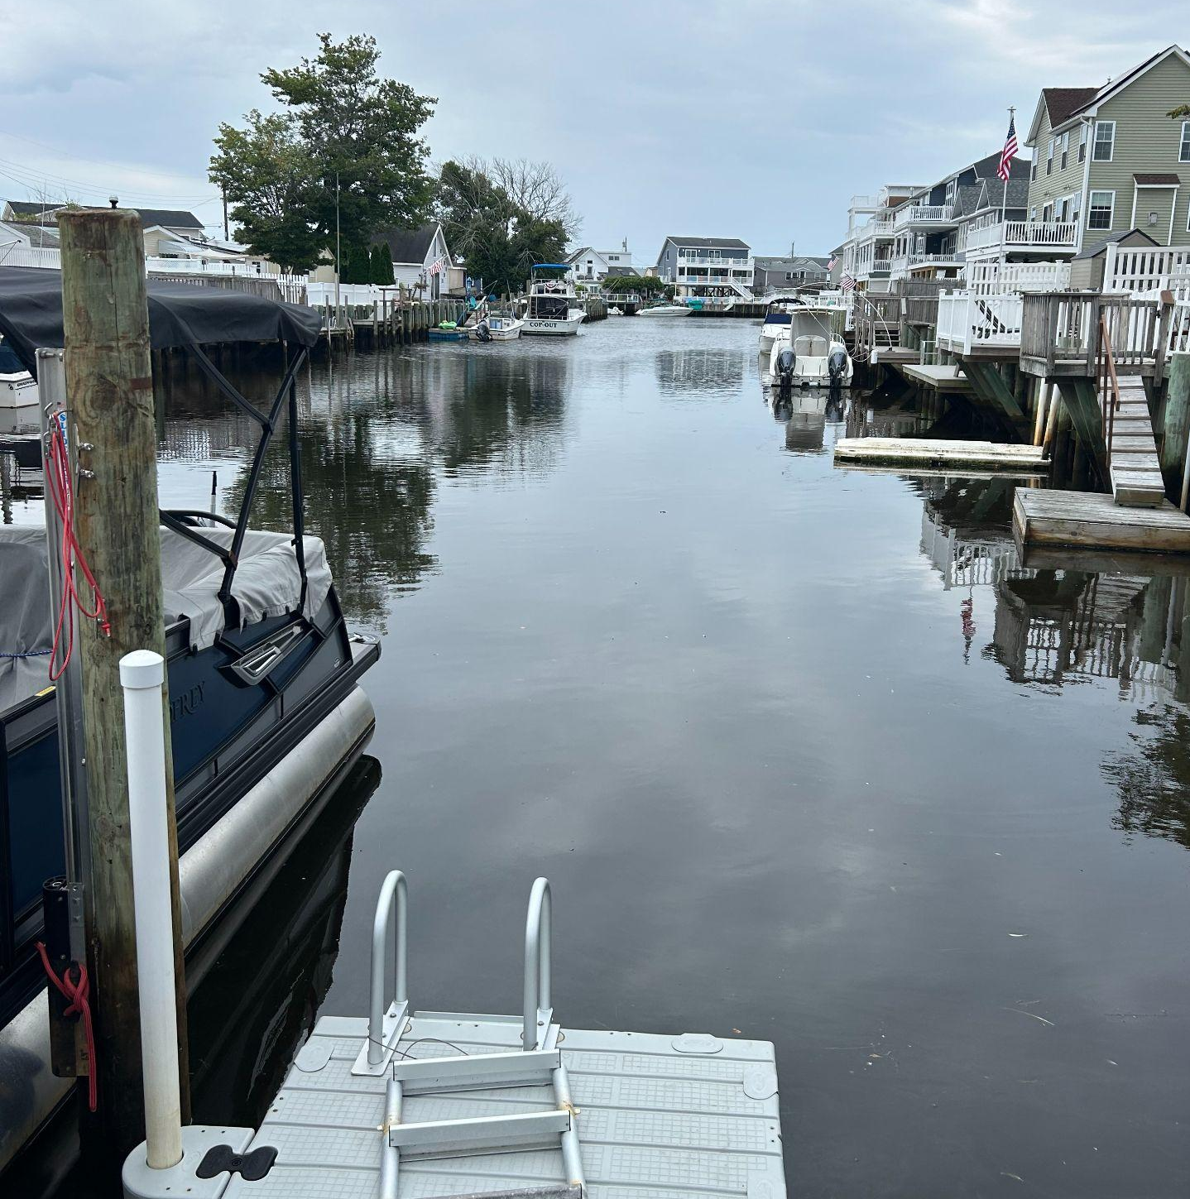
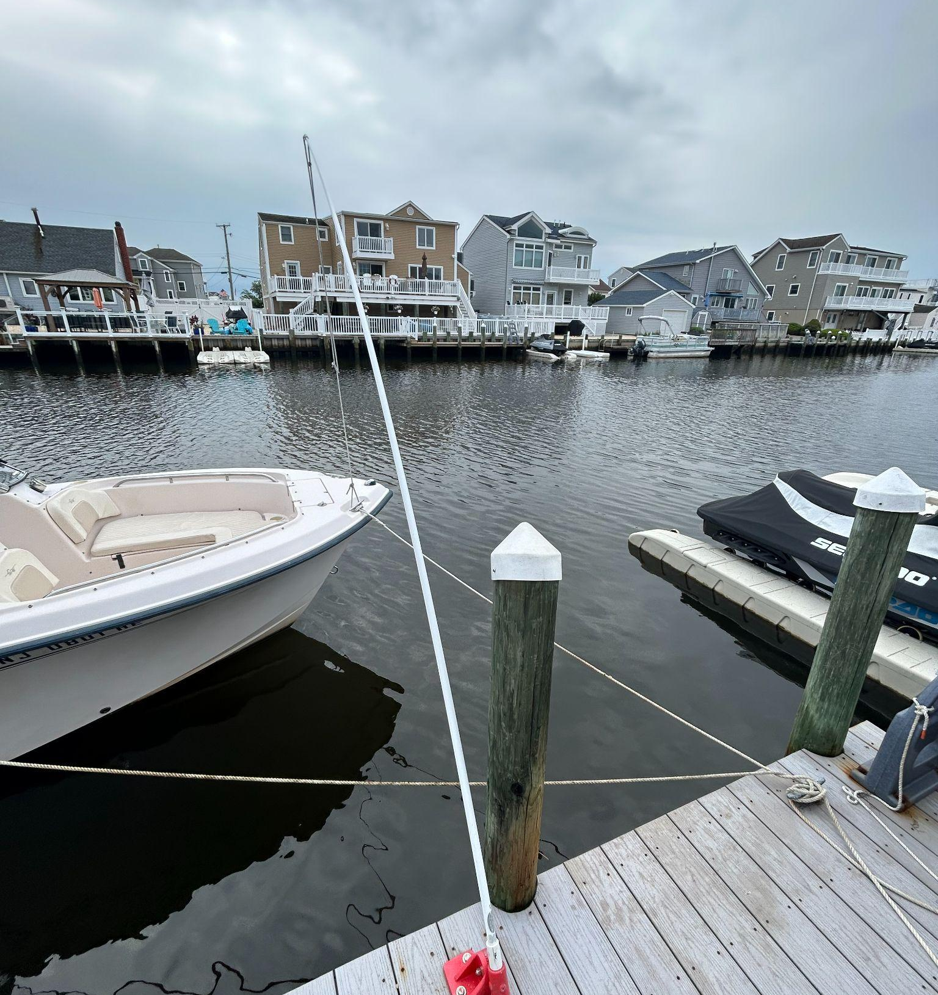
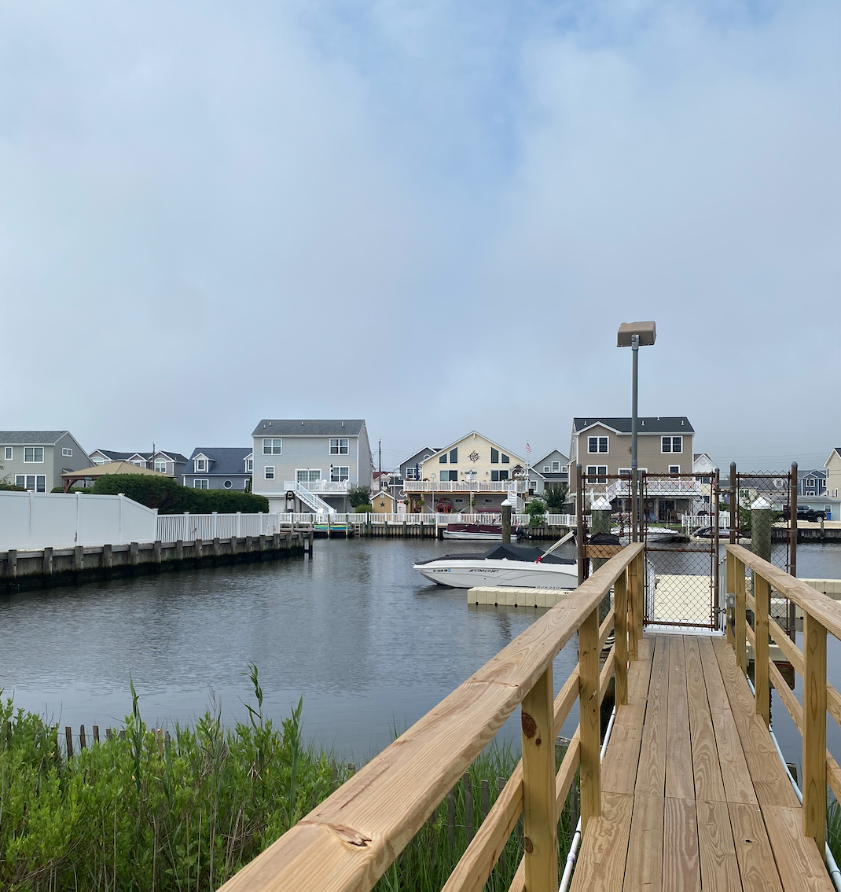




Lagoon Bacteria Study Sites
75 Charles
38 Joshua
Township Dock
1807 Mill Creek

Slide 7
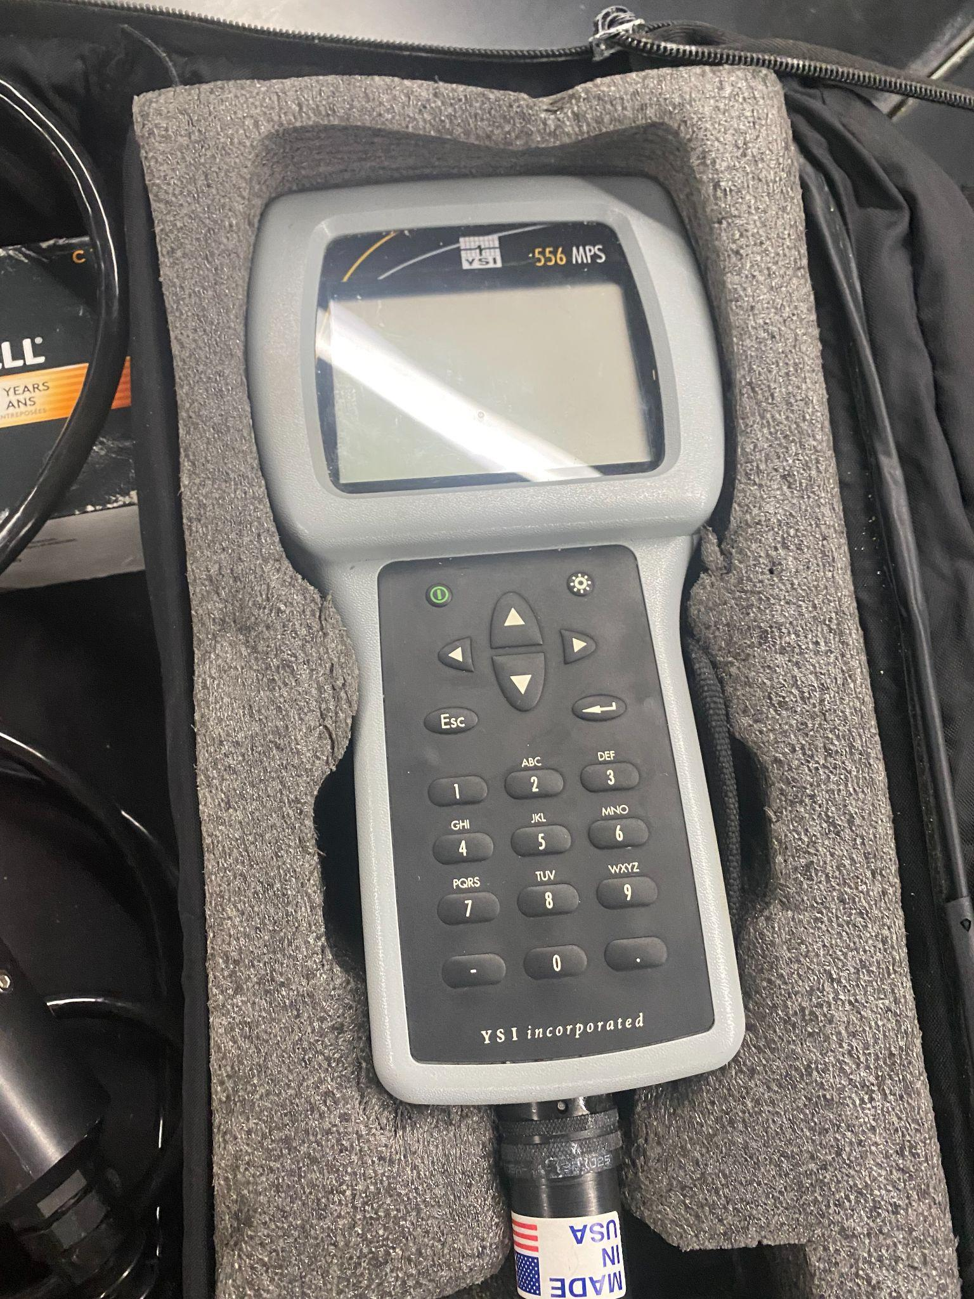
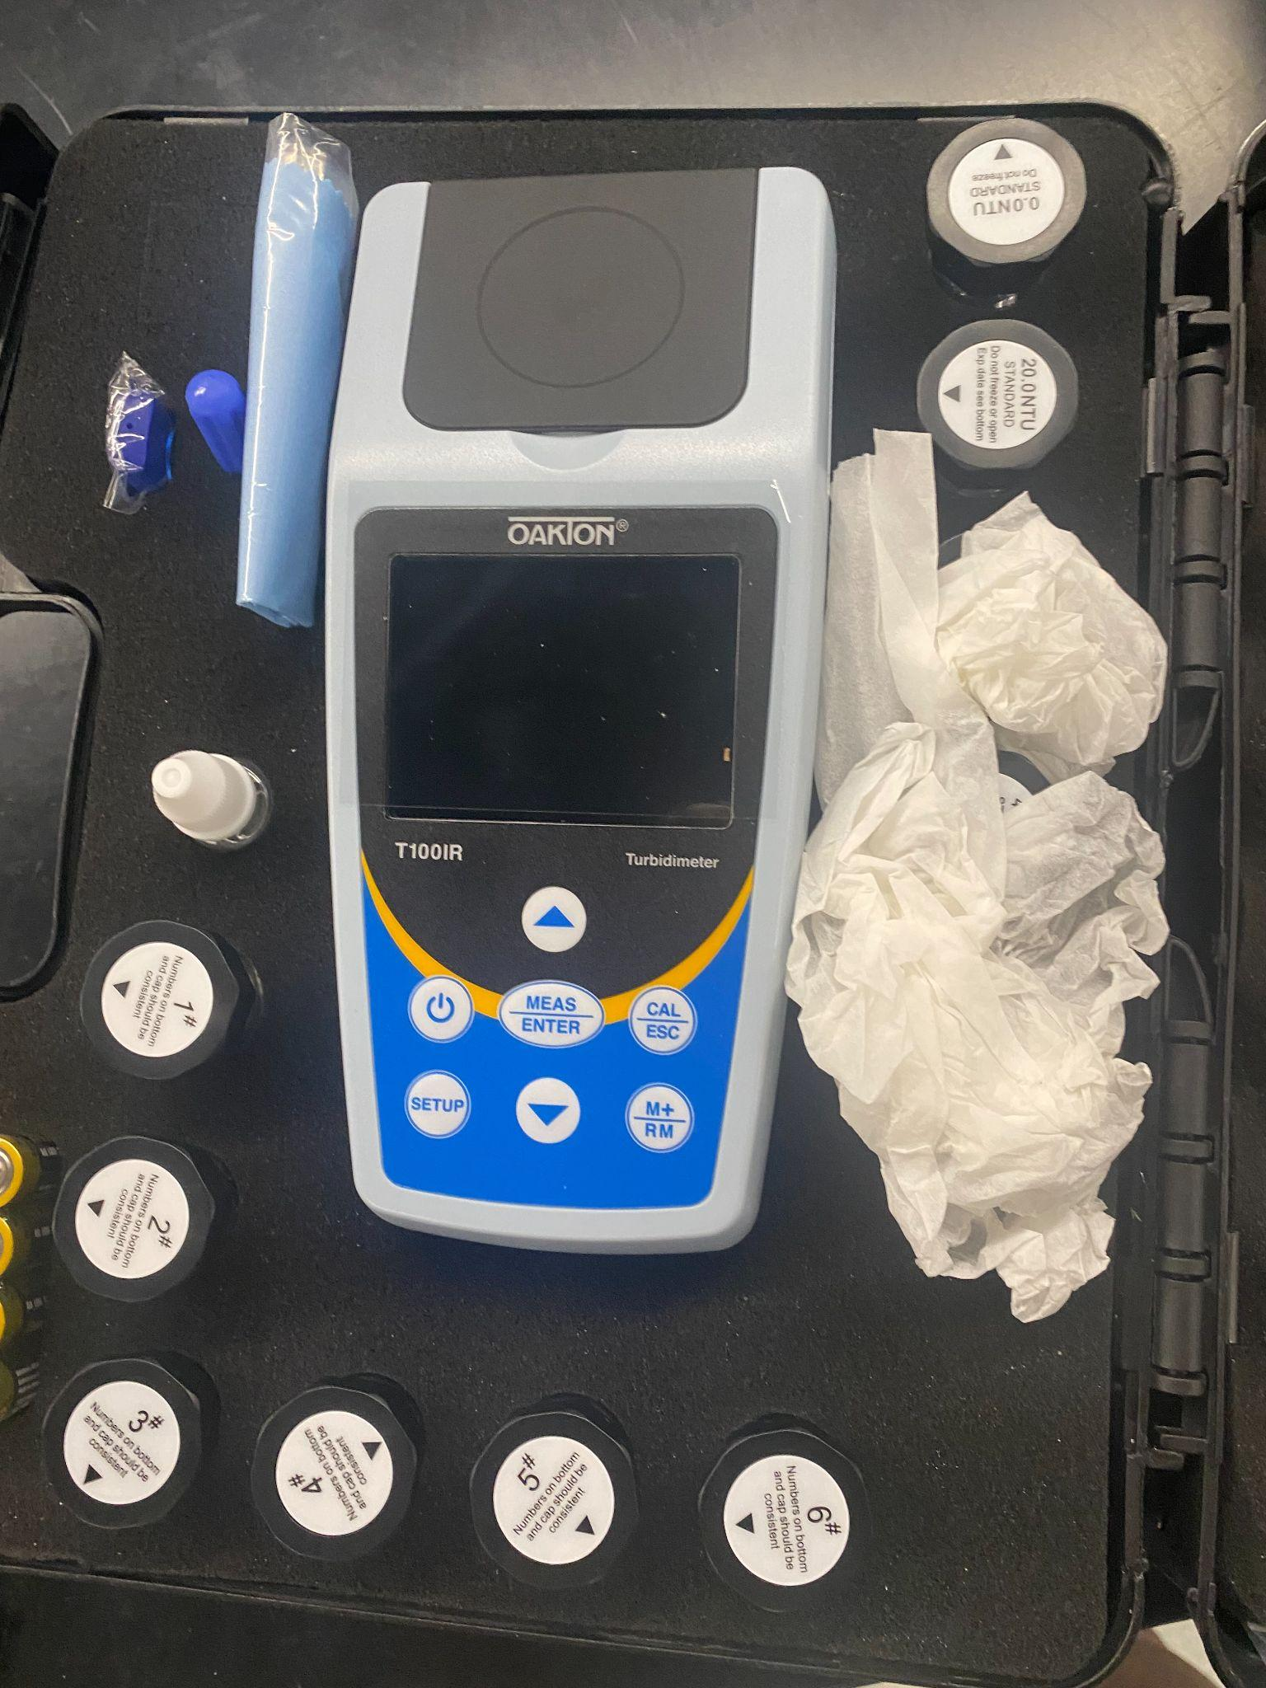
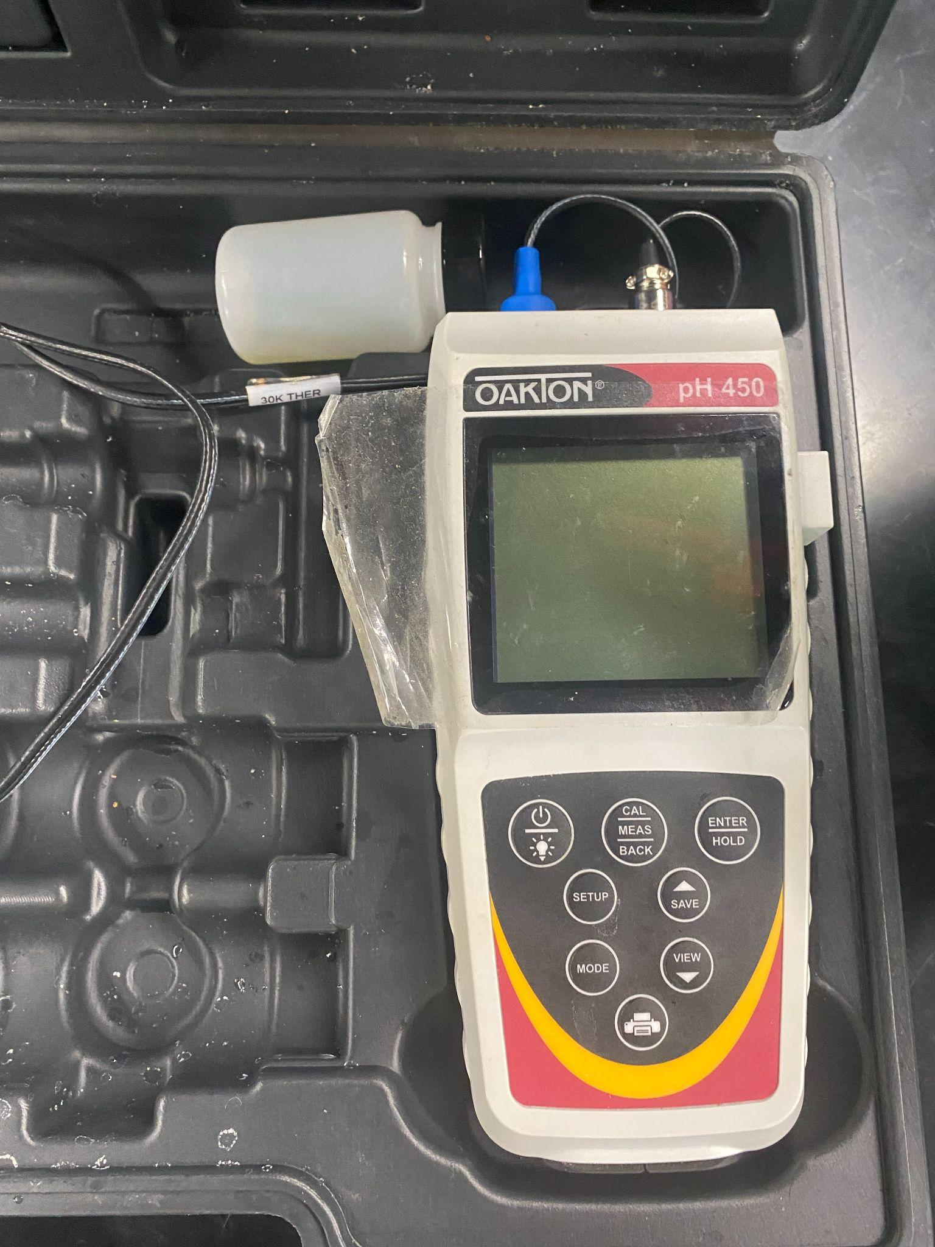
Introduction
Equipment
1
3
YSI 556 Meter
  Temperature (Cº), Conductivity (mS/cm), Salinity (ppt), Dissolved oxygen (ppm)
Oakton pH450
  pH
Oakton Turbidimeter
  Turbidity (NTU)
2

Slide 8
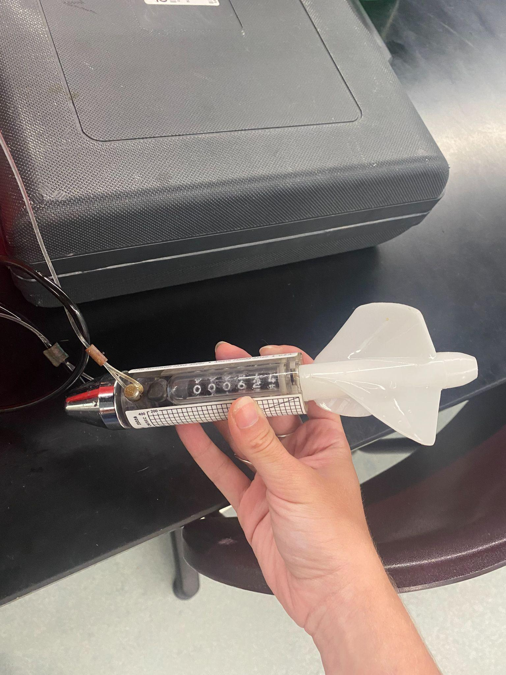
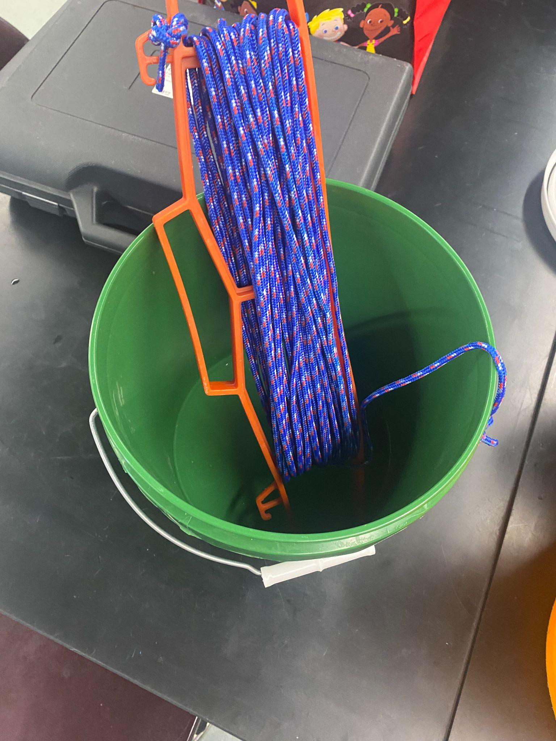
Equipment
1
2
2030 R Flow Meter
  Flow velocity (cm/s)
Collection Bucket
  Used for collection of water samples

Slide 9
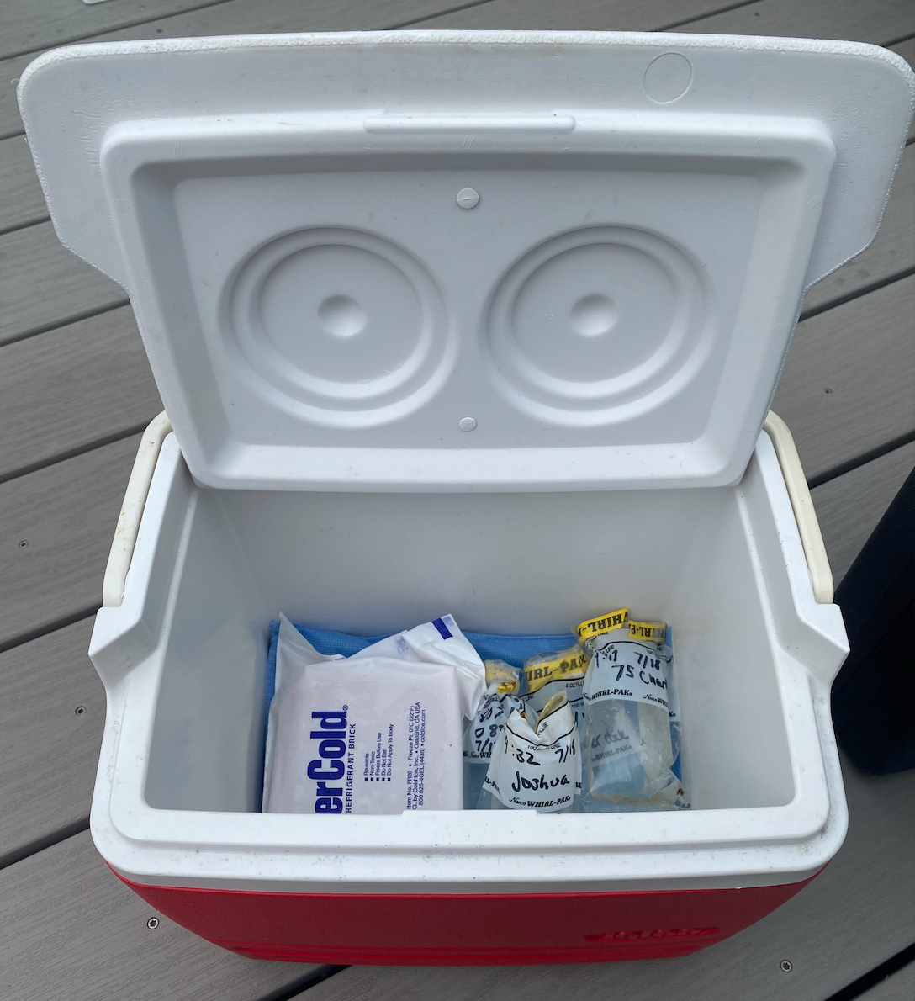
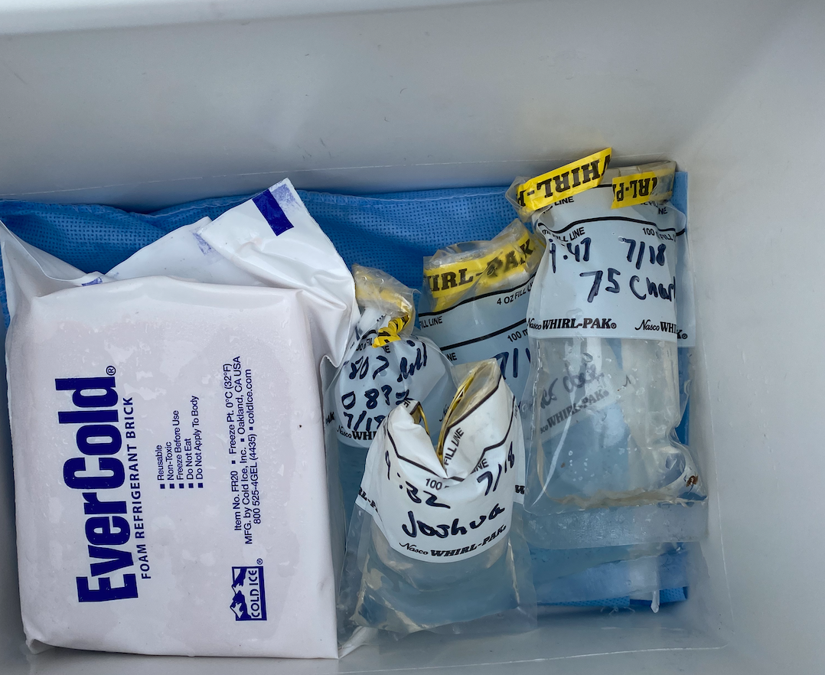
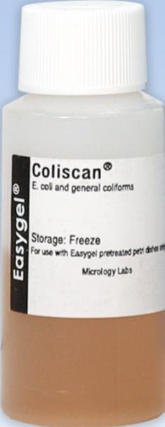
Equipment
Coliscan Easygel (Micrology Laboratories)
Water samples stored in cooler

Slide 10
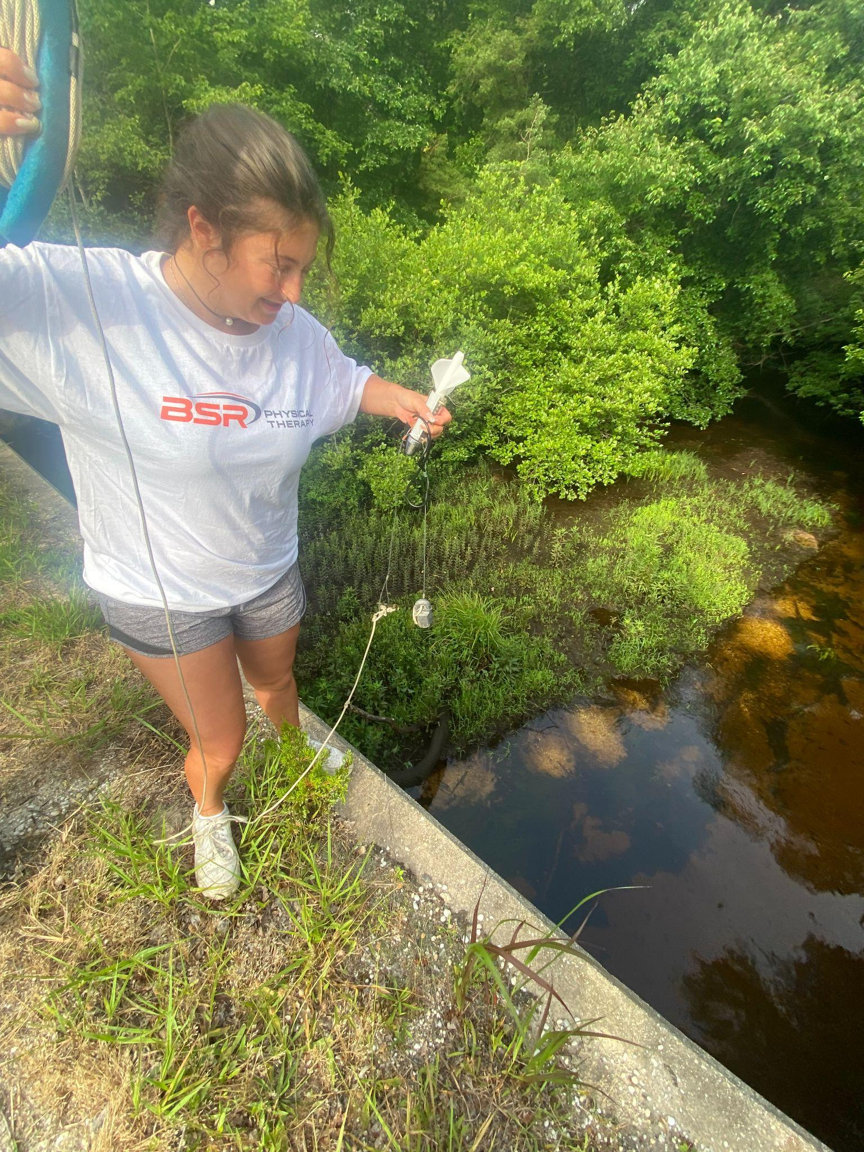
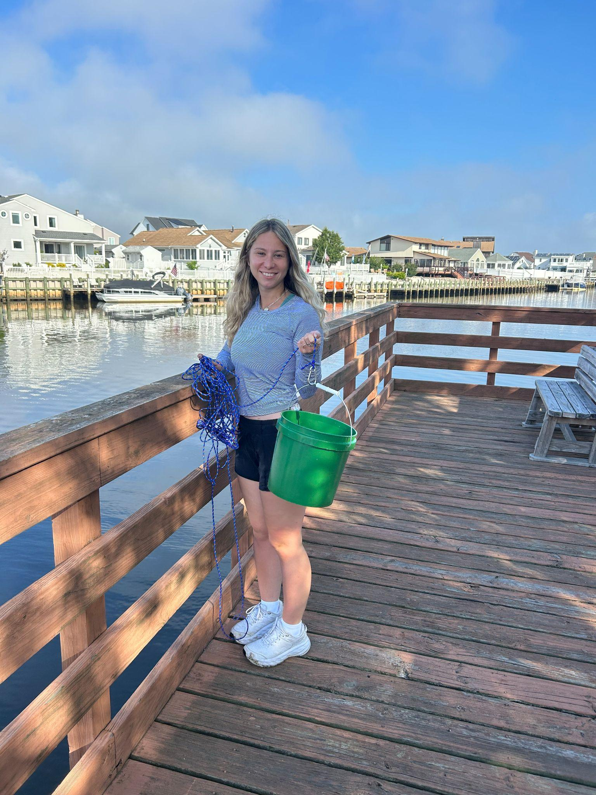
Sampling Methods
Flow Meter
Sampling Bucket

Slide 11
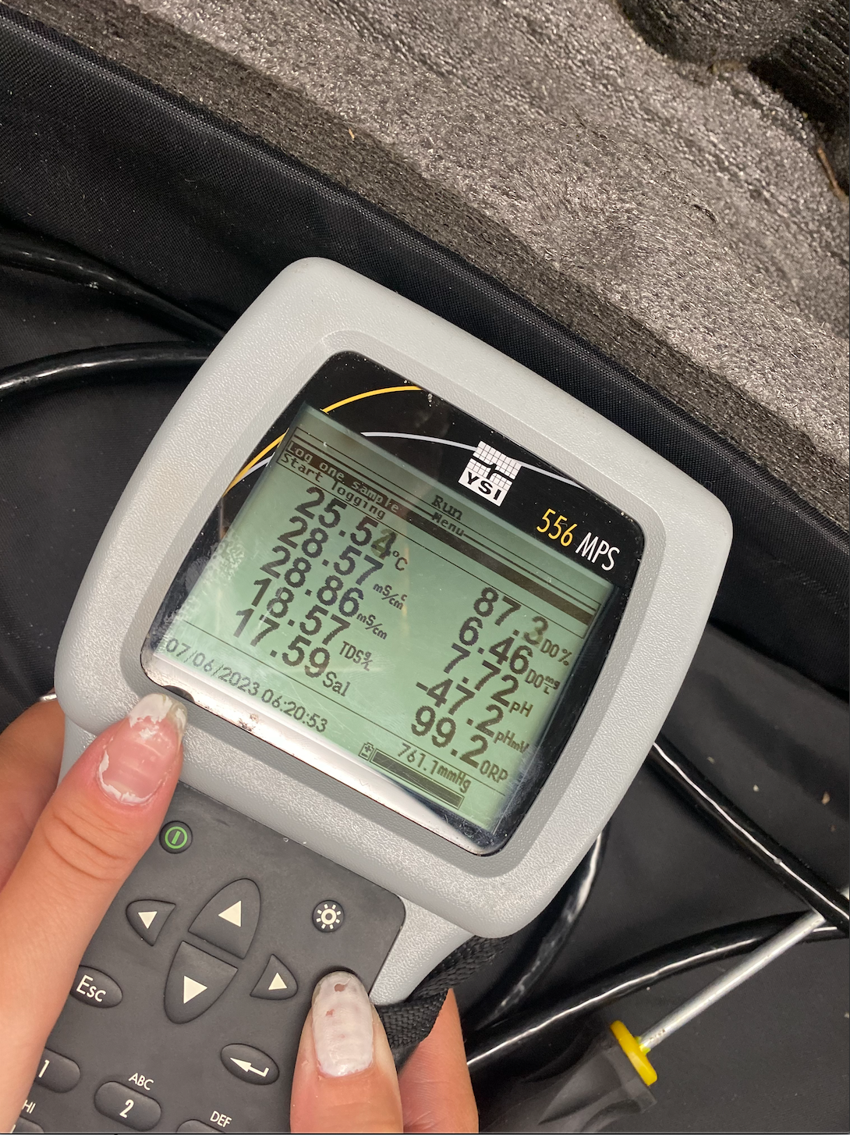
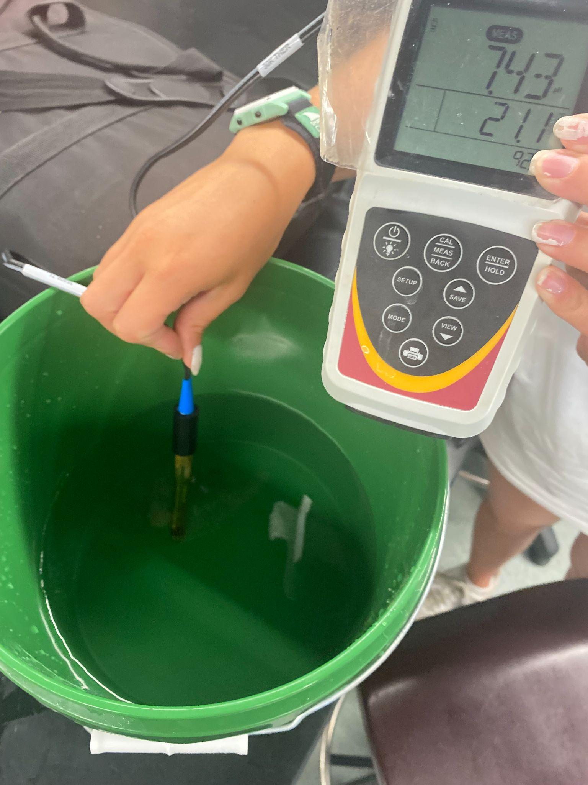
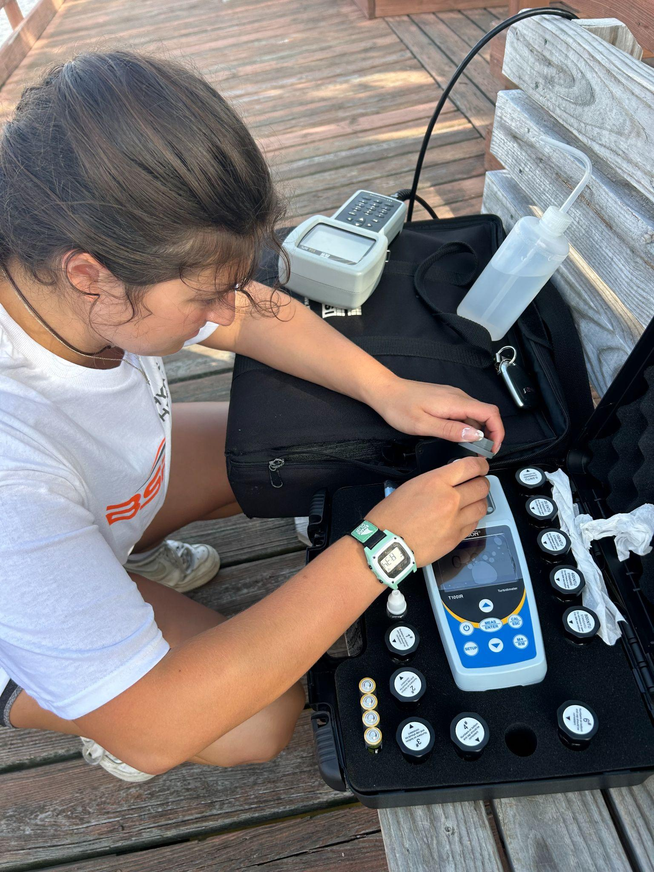
Sampling Methods
YSI meter
pH meter
Turbidimeter

Slide 12
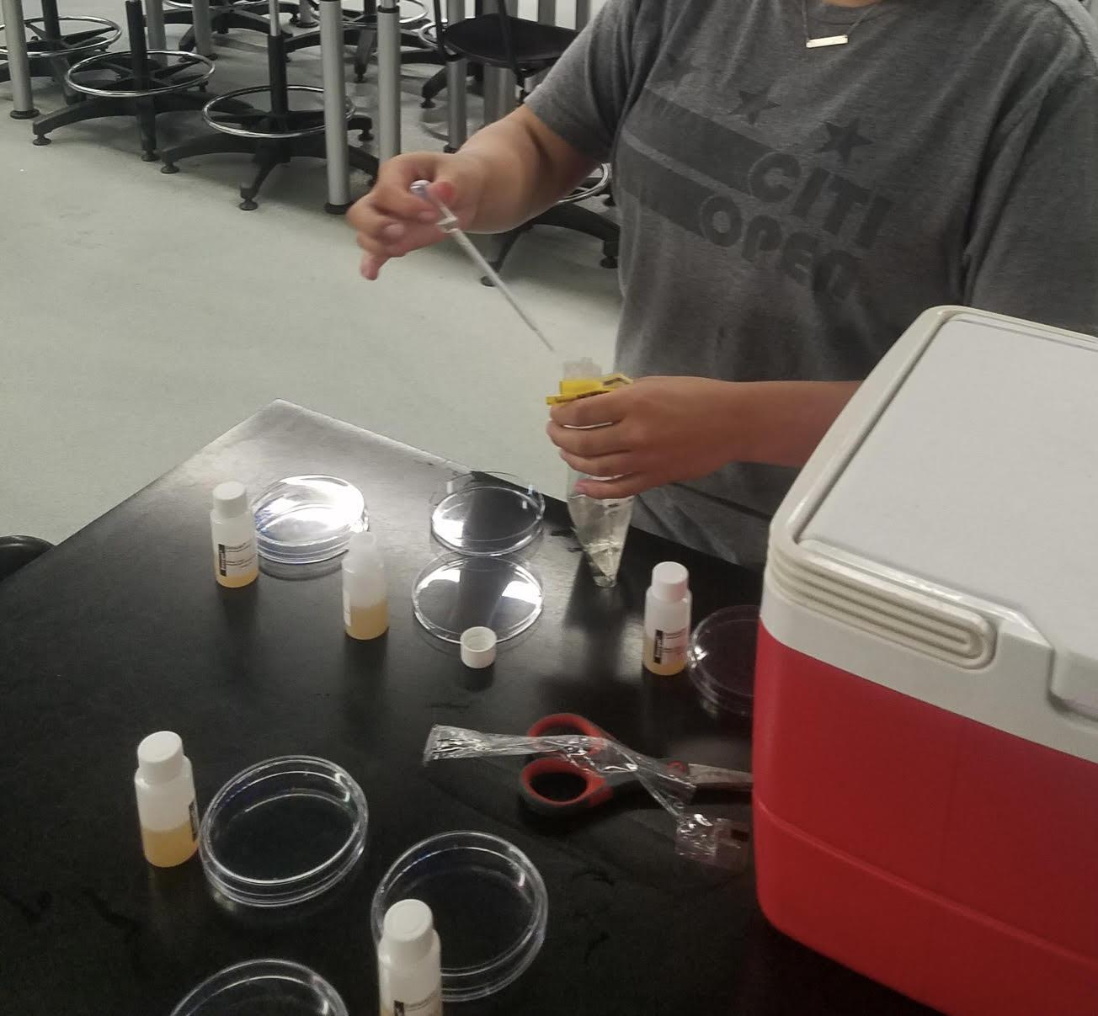
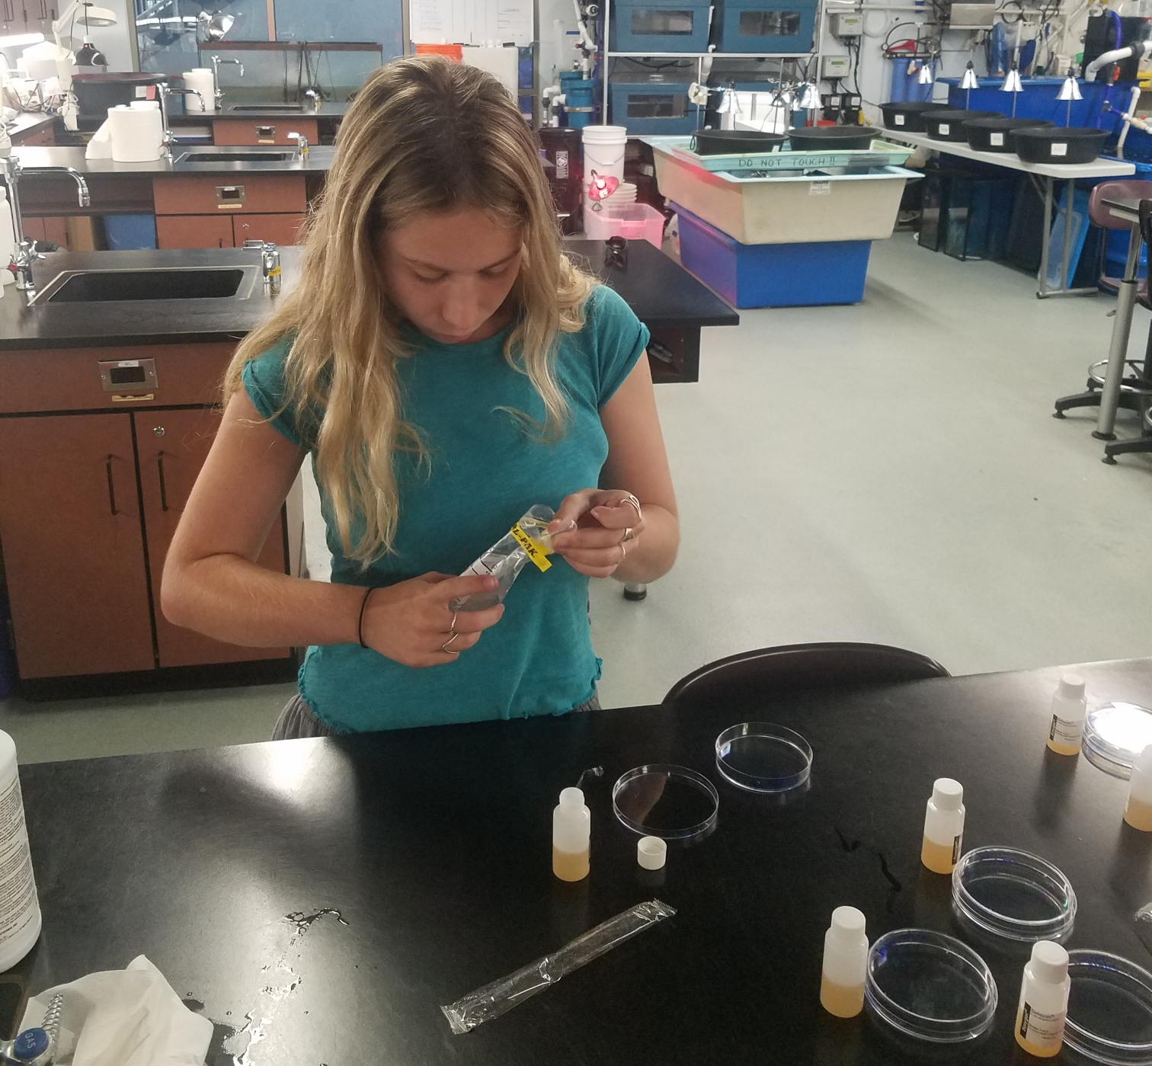
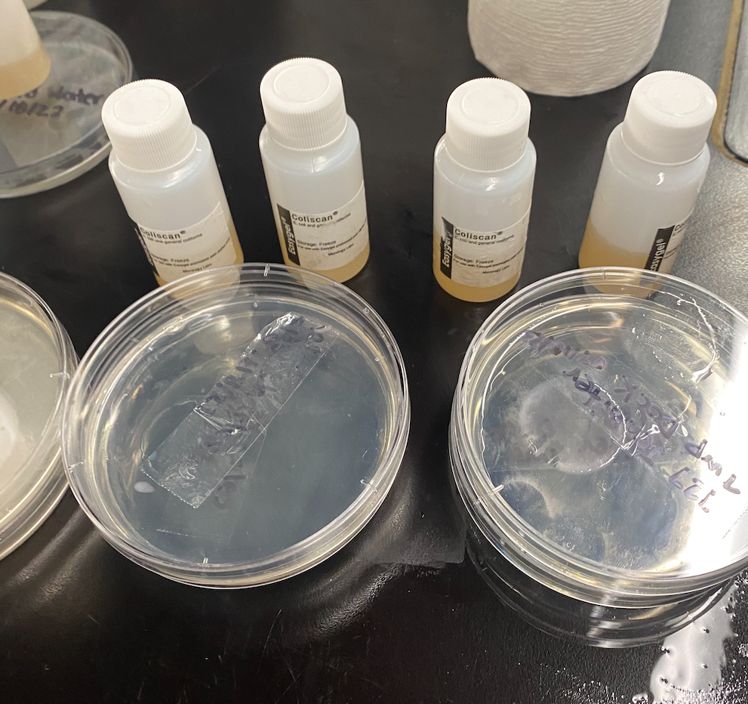
Testing Methods
Coliscan Easygel bottles
Whirl paks
Plated samples

Slide 13
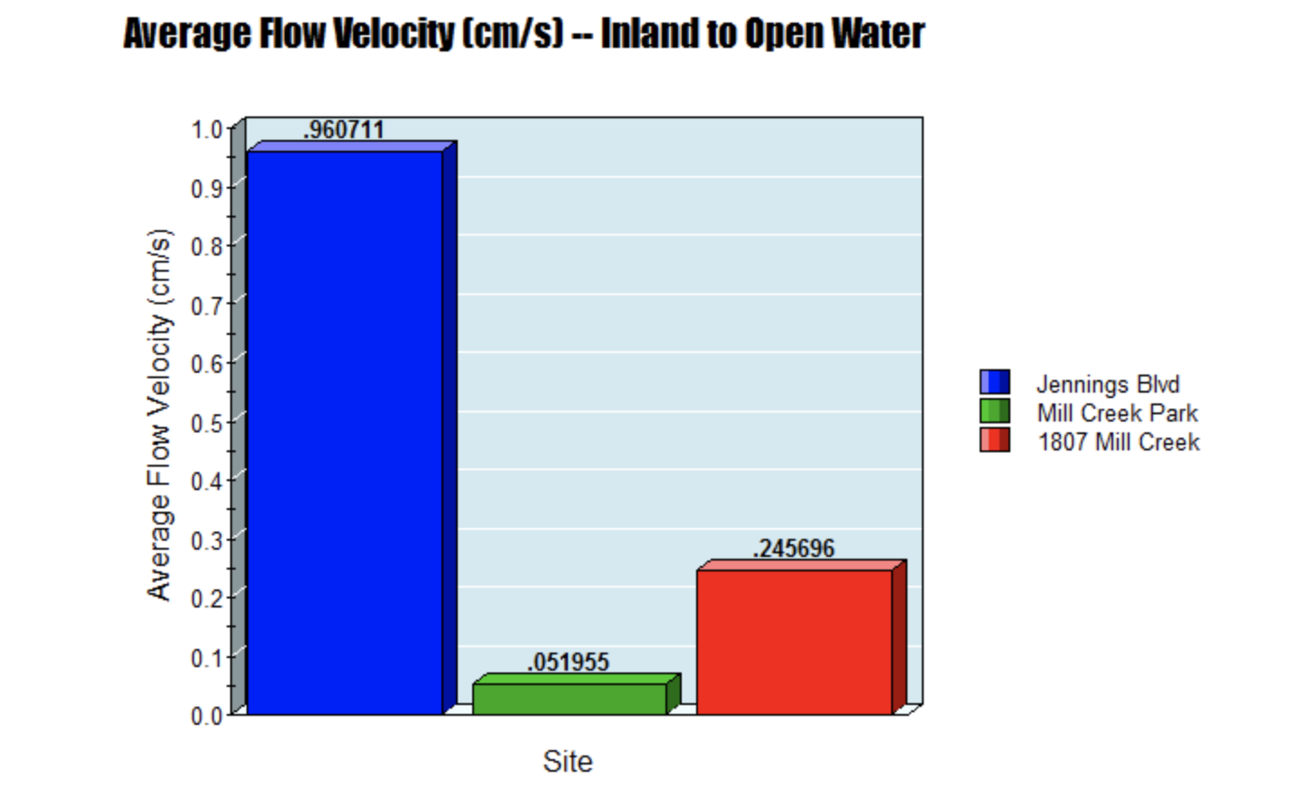
Flow Velocity Data Analysis

Slide 14
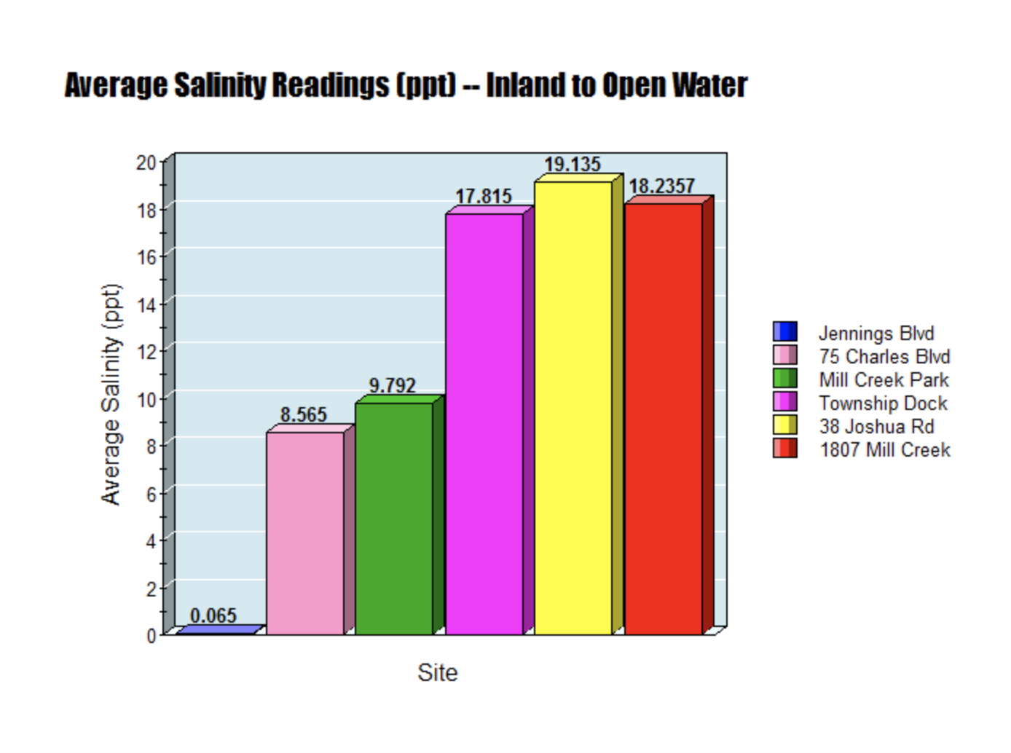
Salinity Data Analysis
Range: 0.03ppt to 23.33ppt
Notes:
Overall, salinity increases as proximity to salt water increases
Lowest salinity reading was 0.03 at Jennings Blvd on 06/20
Highest salinity reading was 23.33 at 38 Joshua on 08/04

Slide 15
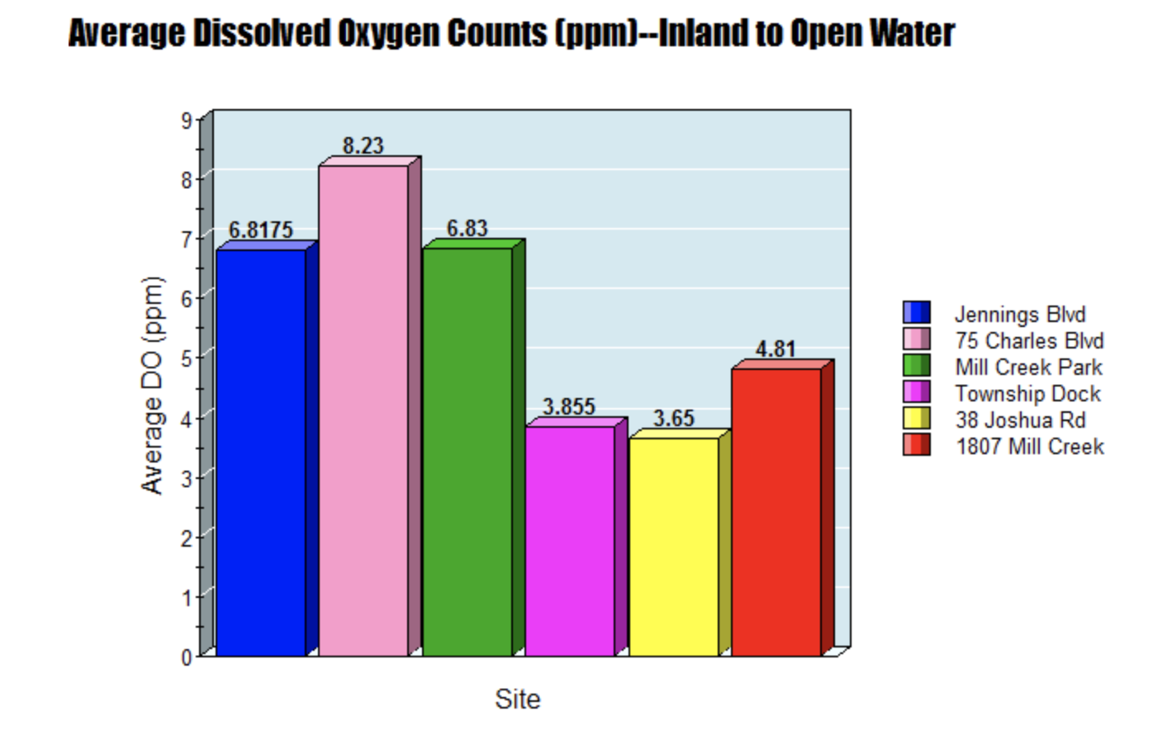
Dissolved Oxygen Data Analysis
Range: 1.65ppm to 9.85ppm
Notes:
- Lowest DO reading was 1.65 at the Township Dock on 08/04
- Highest DO reading was 9.85 at Mill Creek Park on 06/27

Slide 16
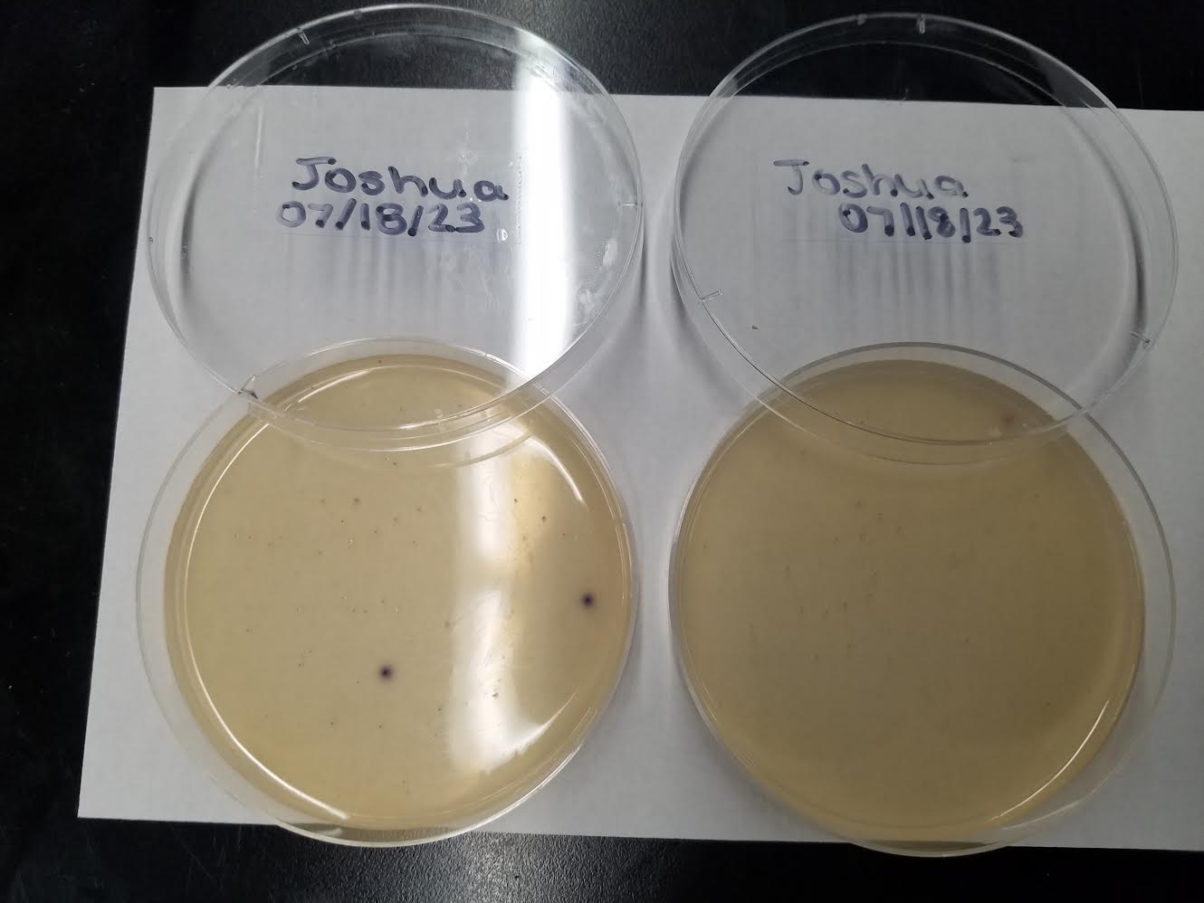
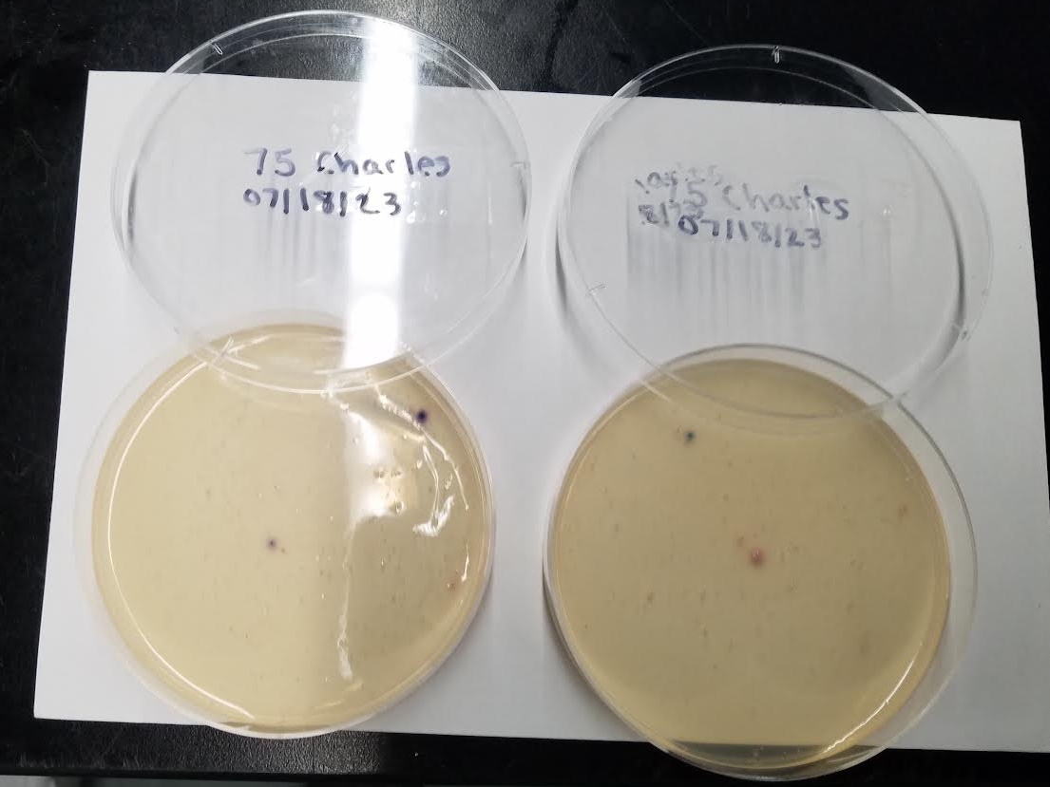
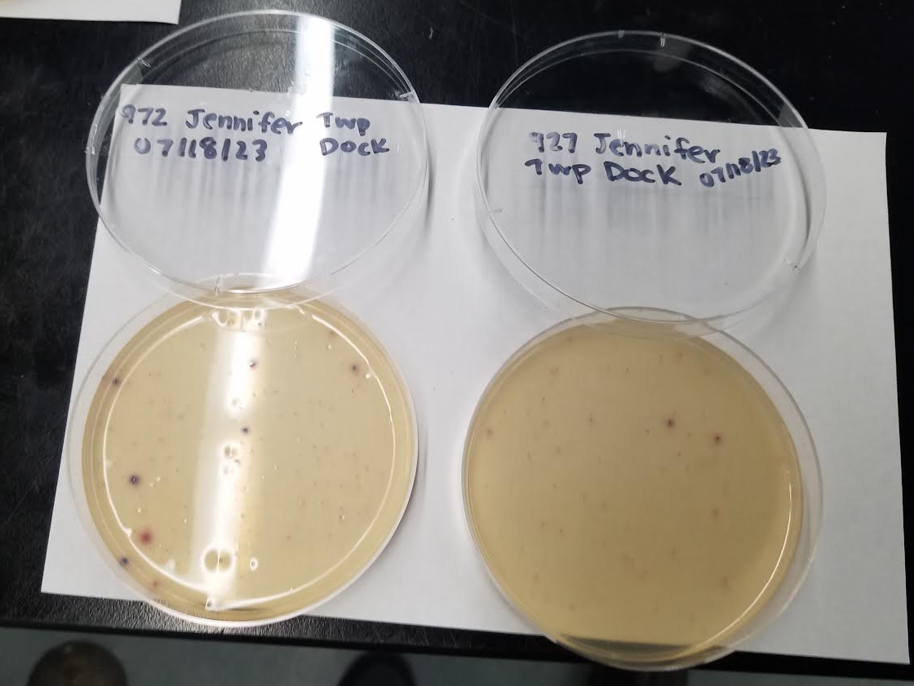
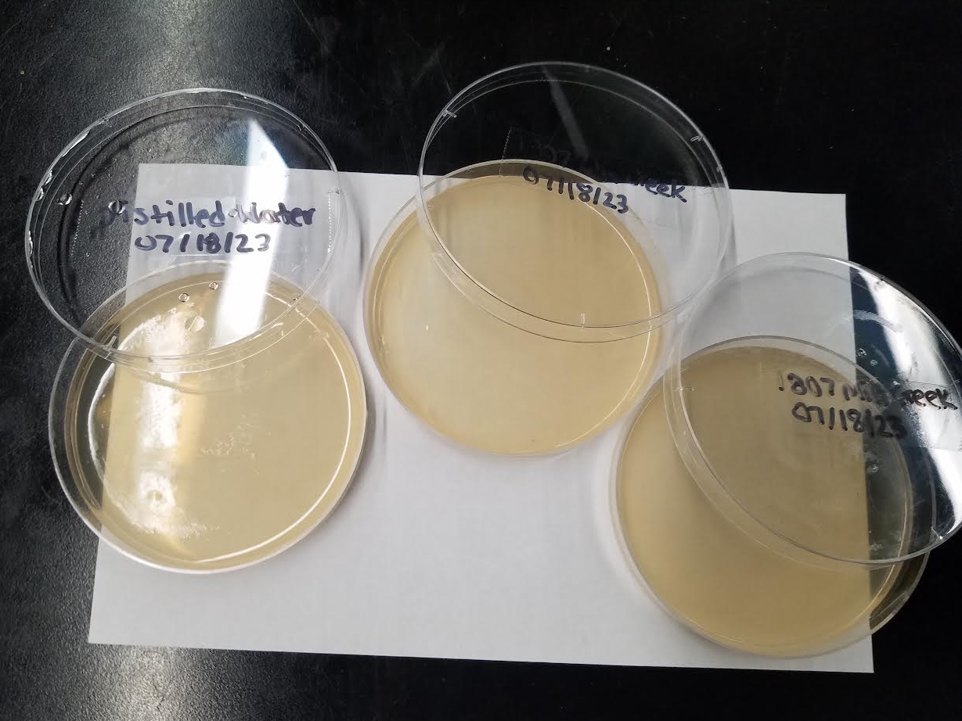
Lagoon Bacteria Analysis (07/18)
38 Joshua
75 Charles
Township dock
Control,
1807 Mill Creek

Slide 17
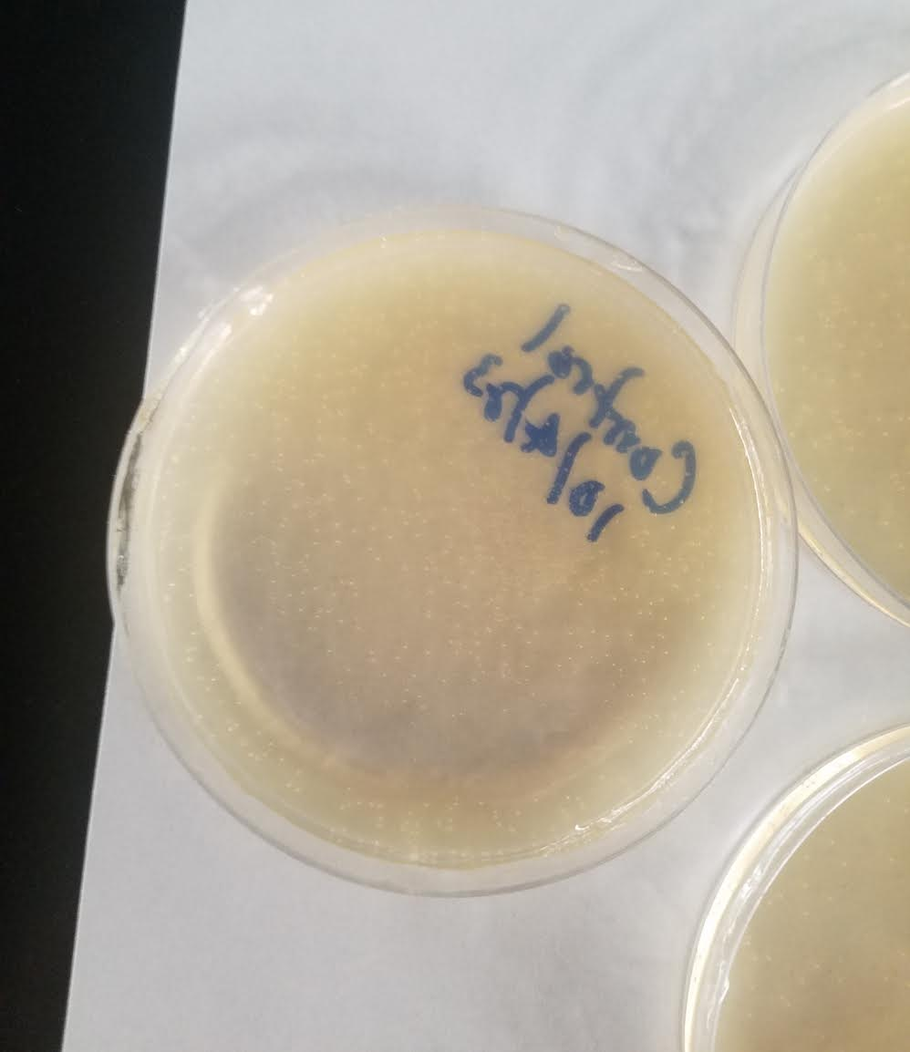
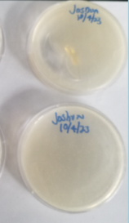
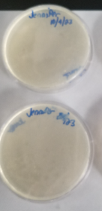
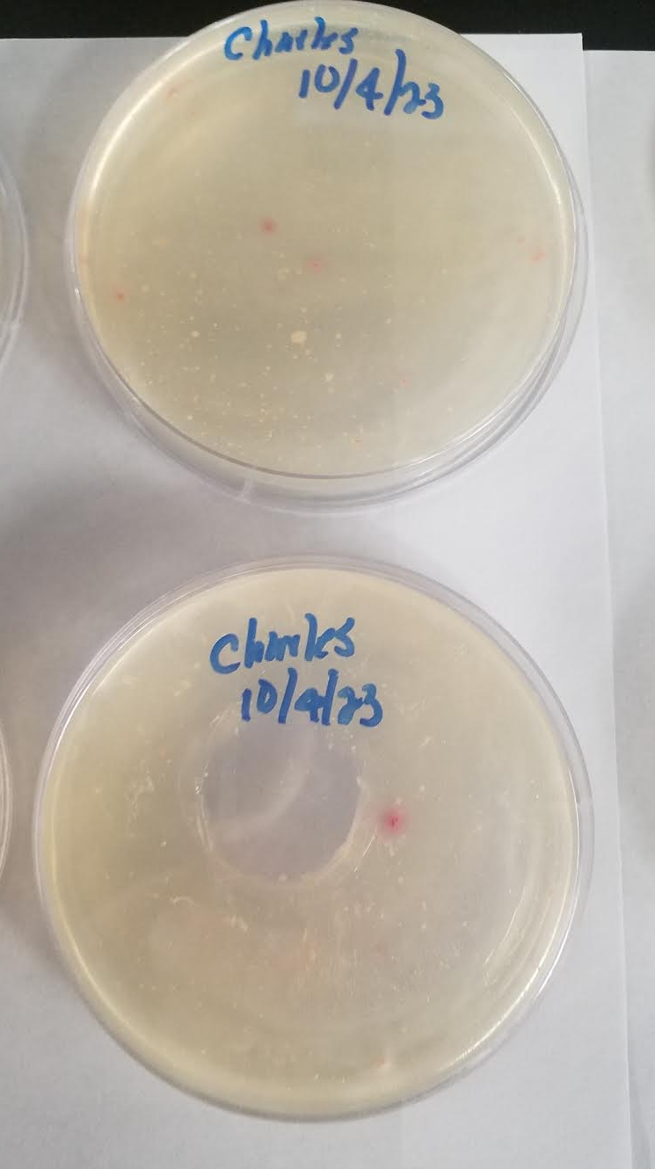
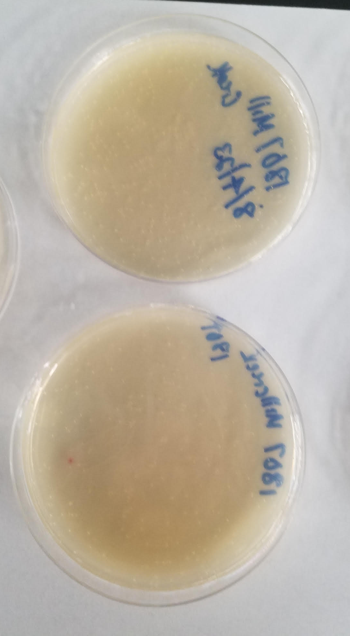
Lagoon Bacteria Data Analysis (08/04)
Control
38 Joshua
Township dock
75 Charles
1807 Mill Creek

Slide 18
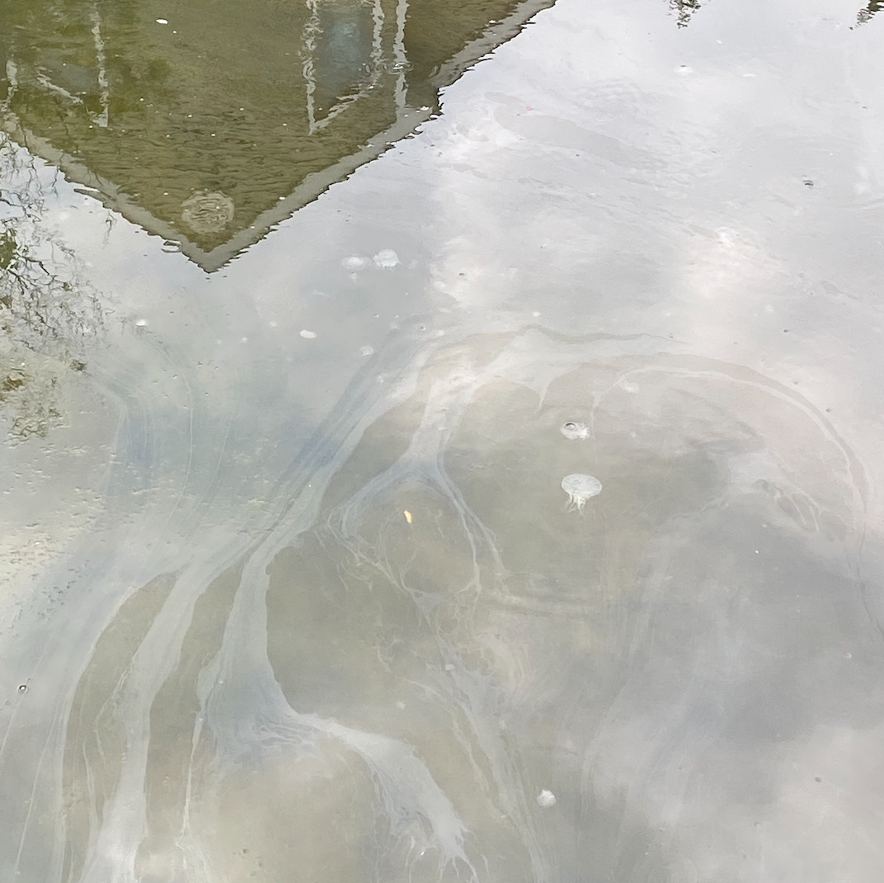
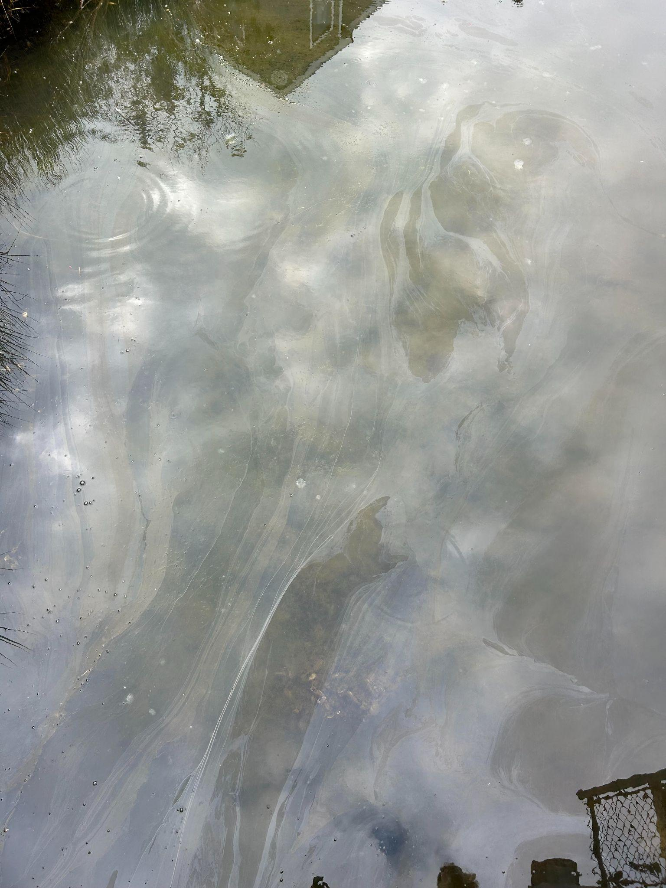
Additional Observations
Bay nettle jellyfish in the water at the Township Dock on 08/04
Notes:
Direct relationship with temperature (25.38C or 77.684F) and inverse relationship with dissolved oxygen (1.65 ppm)

Slide 19
Conclusions
Beach Haven West water is safe for recreation
Water quality parameters should be monitored further by the Civic Association
Helpful practices for homeowners:
  Research fertilizers before use
  Be mindful when interacting with the bay
  Stay involved!

Slide 20
Acknowledgements
-Save Barnegat Bay
- Dr. John Wnek
-The Beach Haven West Civic Association
-Joseph Kosa
-The homeowners in BHW who allowed us to use their properties
-Stafford Township and its residents

Slide 21
THANK YOU!
Any Questions?

